Slide 1

Accessibility & internationalization
Wenxuan Shi
College of Software, Nankai University
Email: shiwx@nankai.edu.cn
Wechat: 13920561100

Slide 2
Topics
Accessibility
Internationalization

Slide 3
Accessibility
Notes:
StatelessWidget is used for immutable elements that only rely on the object configuration information
StatefulWidget is used for elements that can dynamically change based on state-changes in the system
Everytime that state changes, setChange() is called by the object

Slide 4
Introduction
Flutter is committed to supporting developers who want to make their apps more accessible: usable by as many people as possible, including those with disabilities such as blindness or motor impairment.
Flutter supports three components for accessibility support:
Large fonts: Render text widgets with user-specified font sizes
Screen readers: Communicate spoken feedback about UI contents
Sufficient contrast: Render widgets with colors that have sufficient contrast

Slide 5
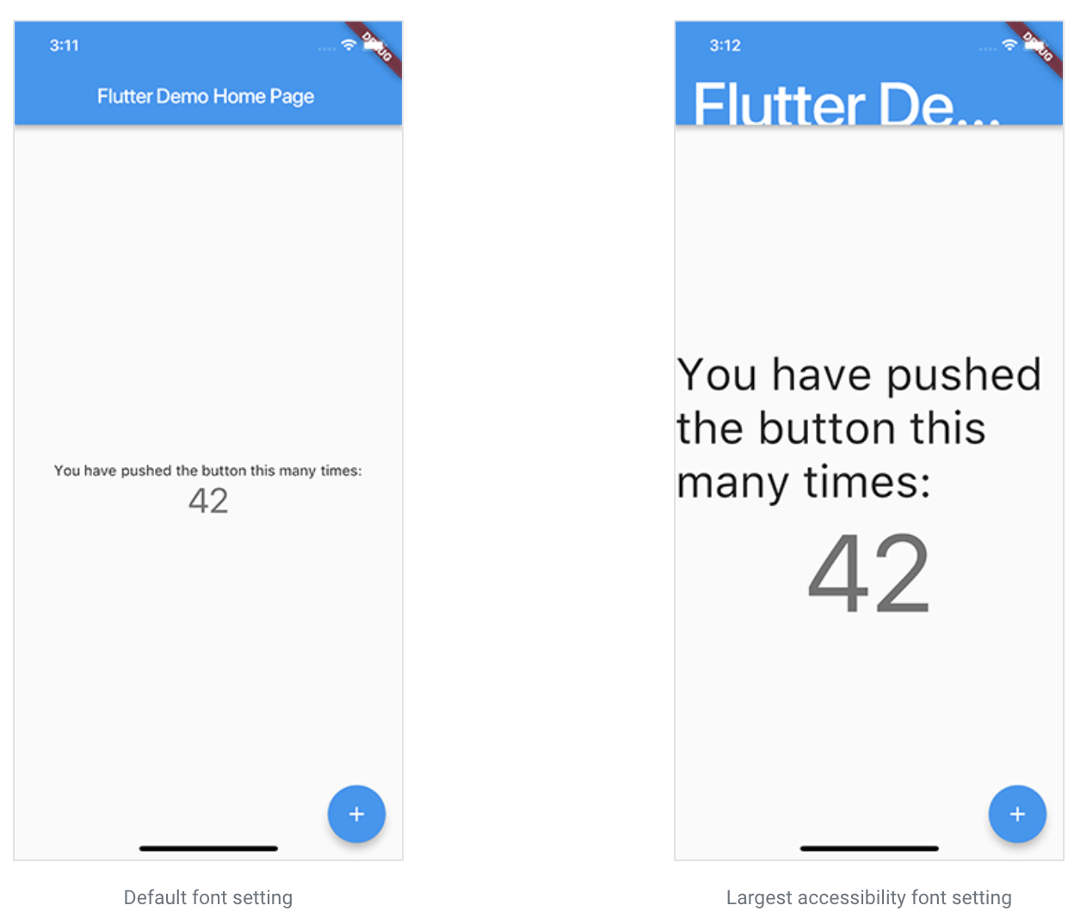
Large fonts

Slide 6
Screen readers
For mobile, screen readers (TalkBack, VoiceOver) enable visually impaired users to get spoken feedback about the contents of the screen and interact with the UI via gestures on mobile and keyboard shortcuts on desktop.

Slide 7
Screen readers
For web, the following screen readers are currently supported:
Mobile Browsers:
iOS - VoiceOver
Android - TalkBack
Desktop Browsers:
MacOS - VoiceOver
Windows - JAWs & NVDA

Slide 8
Sufficient contrast
Sufficient color contrast makes text and images easier to read.
The W3C recommends:
At least 4.5:1 for small text (below 18 point regular or 14 point bold)
At least 3.0:1 for large text (18 point and above regular or 14 point and above bold)

Slide 9
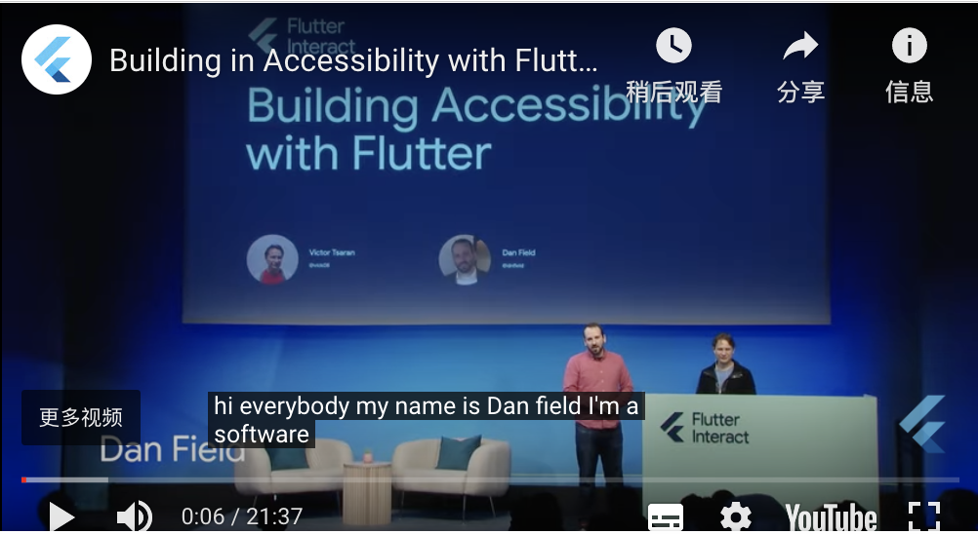
Building with accessibility in mind
Ensuring your app can be used by everyone means building accessibility into it from the start.
See the video below,
https://youtu.be/bWbBgbmAdQs
https://flutter.cn/docs/development/accessibility-and-localization/accessibility#building-with-accessibility-in-mind

Slide 10
Accessibility release checklist
Active interactions. Ensure that all active interactions do something.
Screen reader testing. Test your app with TalkBack (Android) and VoiceOver (iOS).
Contrast ratios. We encourage you to have a contrast ratio of at least 4.5:1 between controls or text and the background, with the exception of disabled components.
Context switching. Nothing should change the user’s context automatically while typing in information.

Slide 11
Accessibility release checklist
Tappable targets. All tappable targets should be at least 48x48 pixels.
Errors. Important actions should be able to be undone.
Color vision deficiency testing. Controls should be usable and legible in colorblind and grayscale modes.
Scale factors. The UI should remain legible and usable at very large scale factors for text size and display scaling.

Slide 12
Internationalization
Notes:
StatelessWidget is used for immutable elements that only rely on the object configuration information
StatefulWidget is used for elements that can dynamically change based on state-changes in the system
Everytime that state changes, setChange() is called by the object

Slide 13
What you’ll learn
How to track the device’s locale (the user’s preferred language).
How to manage locale-specific app values.
How to define the locales an app supports.

Slide 14
Sample internationalized apps
If you’d like to start out by reading the code for an internationalized Flutter app, here are two small examples. The first one is intended to be as simple as possible, and the second one uses the APIs and tools provided by the intl package.
Minimal internationalization
Internationalization based on the intl package

Slide 15
Setting up an internation­alized app
By default, Flutter only provides US English localizations.
To add support for other languages, an application must specify additional MaterialApp (or CupertinoApp) properties, and include a package called flutter_localizations.
As of November 2020, this package supports 78 languages.

Slide 16
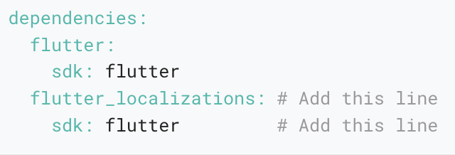
To use flutter_localizations, add the package as a dependency to your pubspec.yaml file:

Slide 17
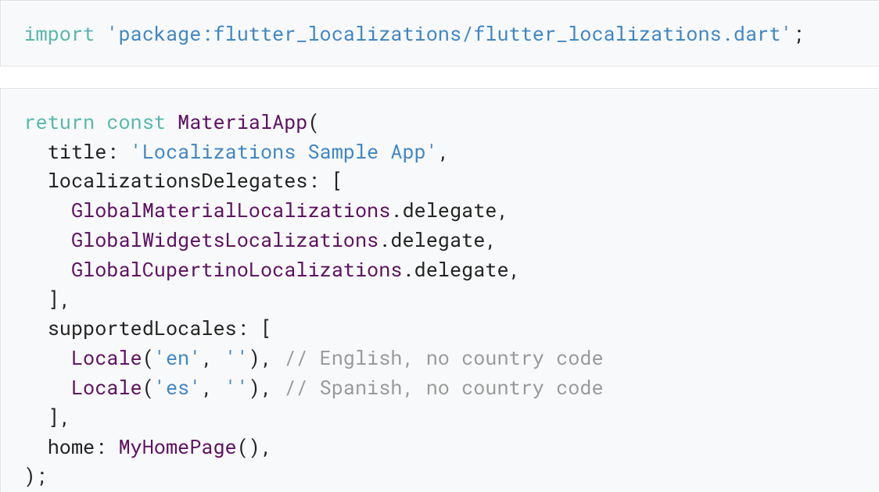
Next, run pub get packages, then import the flutter_localizations :

Slide 18
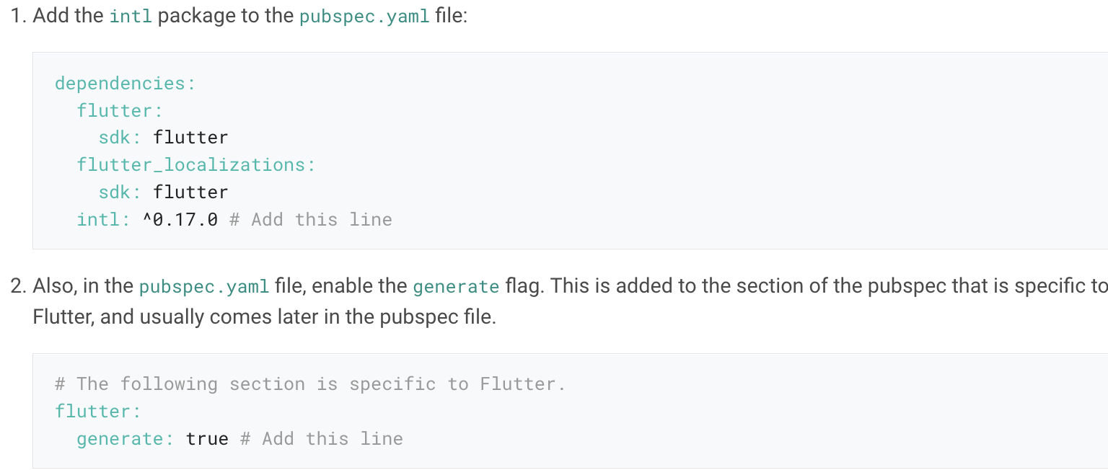
Adding your own localized messages
Once the flutter_localizations package is added, use the following instructions to add localized text to your application.

Slide 19
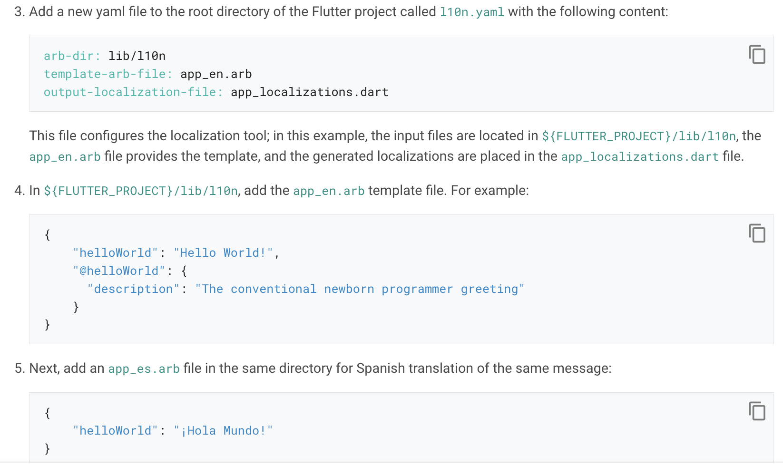
Adding your own localized messages

Slide 20
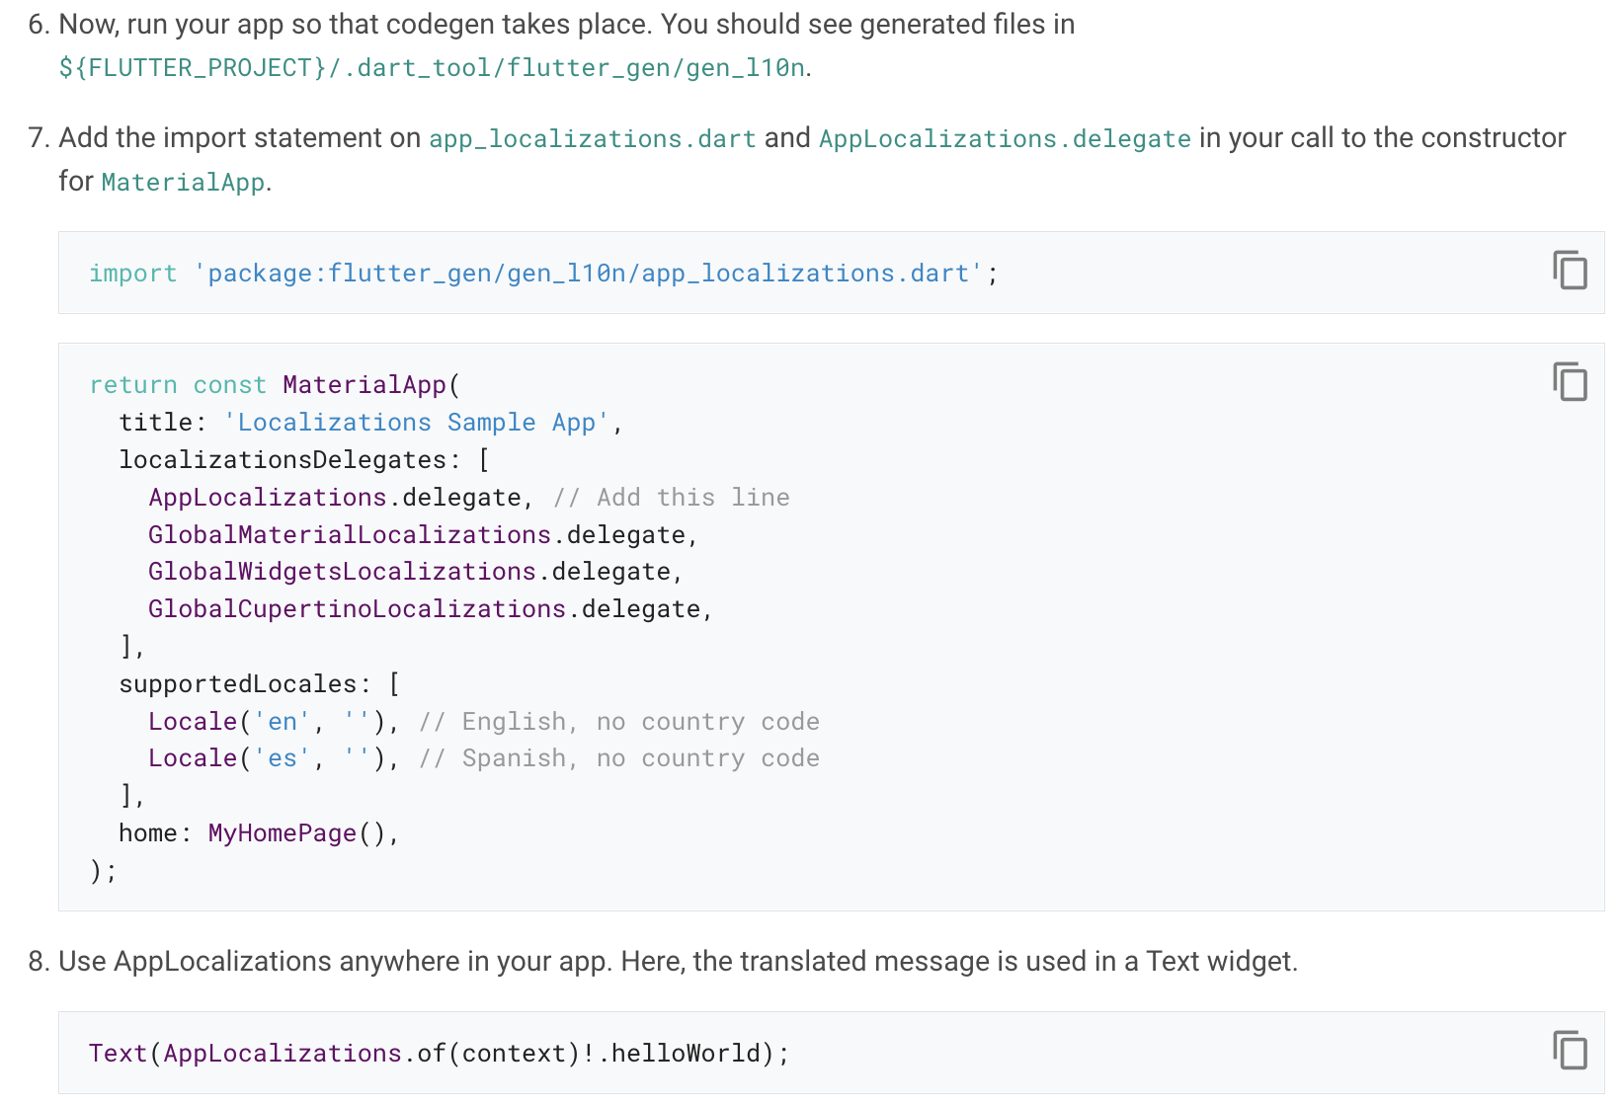
Adding your own localized messages

Slide 21
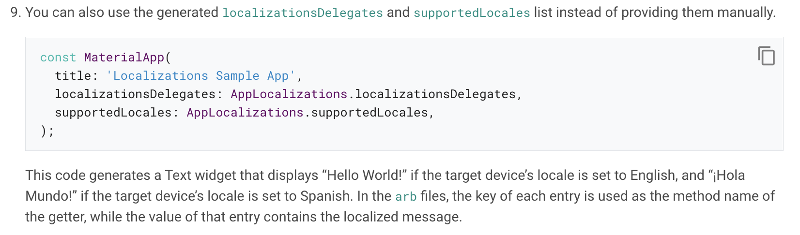
Adding your own localized messages

Slide 22
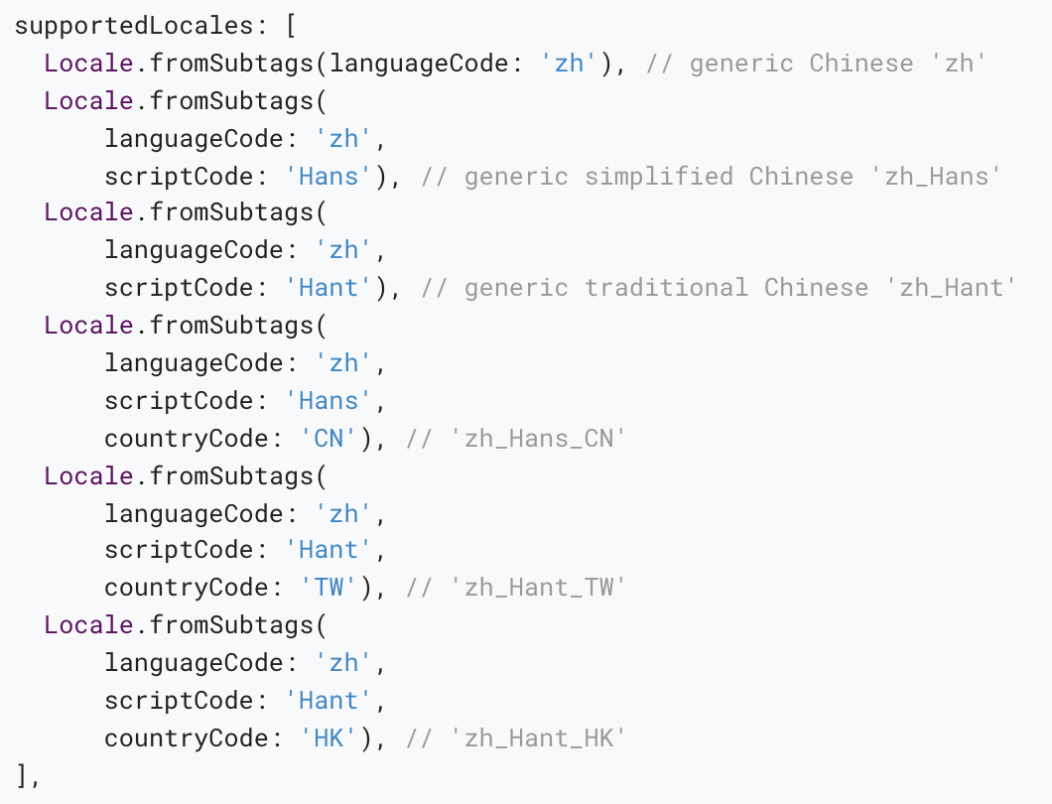
Advanced locale definition
Some languages with multiple variants require more than just a language code to properly differentiate.
Example: In order to fully express every variant of Chinese for the country codes CN, TW, and HK, the list of supported locales should include:

Slide 23
Tracking the locale
The Locale class identifies the user’s language.
The Localizations widget defines the locale for its child and the localized resources that the child depends on.
The WidgetsApp widget creates a Localizations widget and rebuilds it if the system’s locale changes.

Slide 24
Thank you!
Wenxuan Shi
College of Software, Nankai University
Email: shiwx@nankai.edu.cn
Wechat: 13920561100

